Slide 1
Is Pedestrian & Bicycle Master Planning a Chronic Disease Strategy?
Session B02:
“Proliferating Local Policies for Healthier Built Environments”
Amy A. Eyler, PhD
Angie L. Cradock, ScD
Carolyn Voorhees, PhD
David Levinger, PhD
Chronic 2009 Conference - National Harbor, MD
2/23/2009

Slide 2
Objectives
To discuss Analysis of Master Plan (AMP study)
To discuss policies associated within these plans
To discuss ways to collaborate and be involved in transportation and land use decisions

Slide 3

Physical Activity Policy Research Network (PAPRN)

Slide 4

PAPRN
The mission is to conduct transdisciplinary policy research by:
  identifying physical activity policies
  identifying the determinants of the policies
  describing the process of implementing policies
  determining the outcomes of physical activity policies

Slide 5
Physical Activity Policy Framework
Policy
Outcomes of Policy
Develop and Implement Policy
Determinants of Policy
Identify Policies
Health
Transportation
Local
Parks/Public Spaces
Regional
State
Worksite
National
Sector Scale
School
Notes:
With input from experts at CDC, academia, multiple sectors, and key partners including RWJF, NIH we developed a conceptual framework to better visualize, categorize, and understand our research and programmatic efforts in physical activity policy. The important components or aspects of policy are found on the vertical axis and the settings in which policy apply are defined by the sector and scale axes.
For example, I will talk in more detail about a worksite policy at CDC (local scale) that is being developed and implemented to improve access for physical activity.

Slide 6
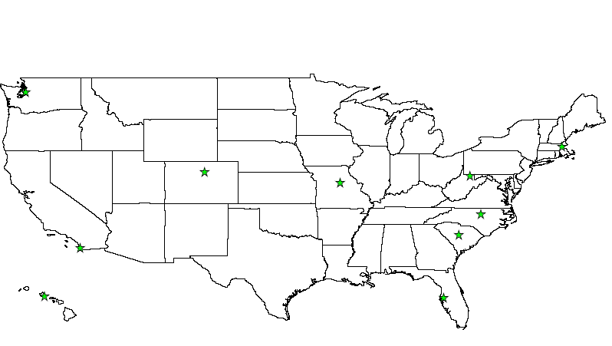

Sites involved with the Physical Activity Policy Research Network
University of Washington
University of Colorado
University of Maryland
Saint Louis
Harvard University
Purdue University
San Francisco State University
West Virginia University
University of North Carolina
San Diego State University
University of South Carolina
University of Hawaii
Centers for Disease Control
and Prevention
University of South Florida

Slide 7
Other PAPRN Studies
Completed studies:
  Active Transport to School
  Multi-use Trail Development
  Concept Mapping
  Physical Education Policy Legislation at the State Level
In Progress:
  AMP Study
  Trail legislation
  Supplement to JPAH on PA policy

Slide 8
What is a Bicycle /Pedestrian Master Plan?
formal transportation and/or land-use plans to improve conditions and supports for walking and bicycling
includes planned routes and paths for bicycles and pedestrian use
provides guidance on facility designs
establishes policies to support safe use of these routes and facilities

Slide 9



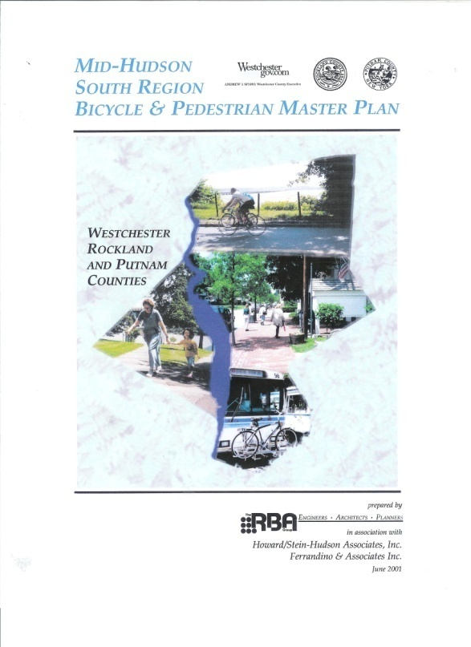
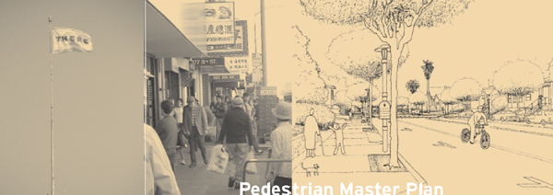


Slide 10
Why are these plans important?
Helps promote an activity-friendly environment
  “A place that makes it easy to choose to be physically active, through planned exercise or routine daily activity”
Has the potential to improve health by increasing activity, decreasing pollution, and improving community social capital
Incorporates community and transdisciplinary input

Slide 11
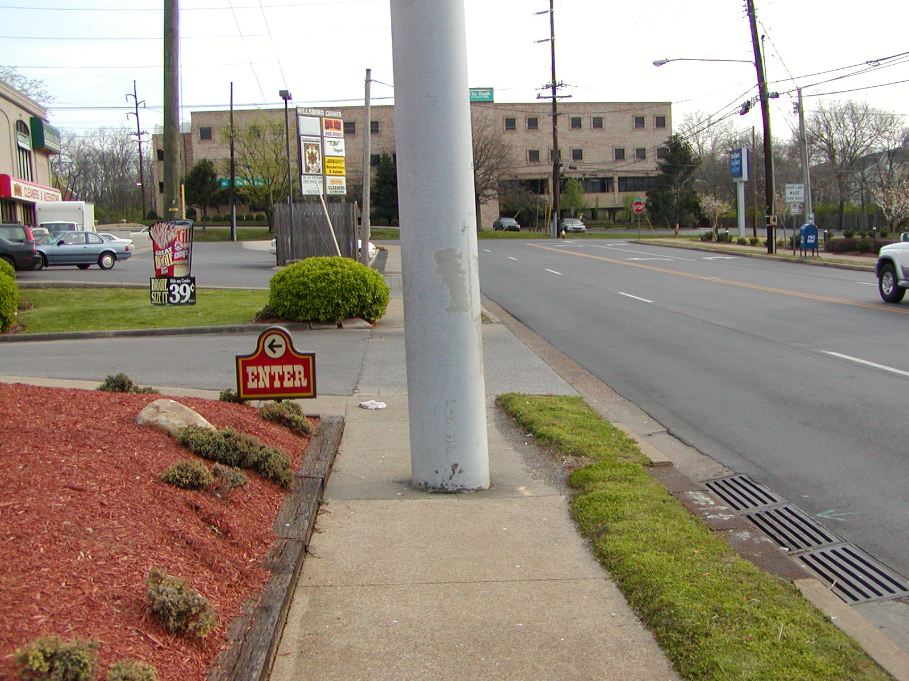

Slide 12
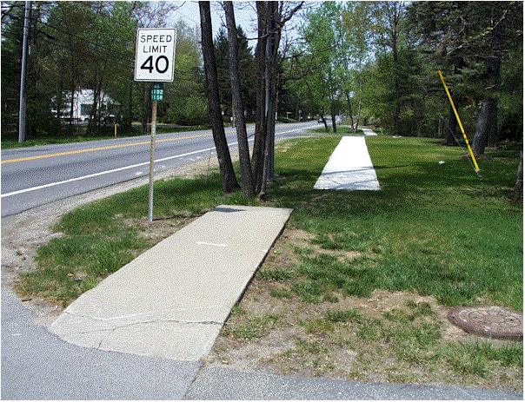
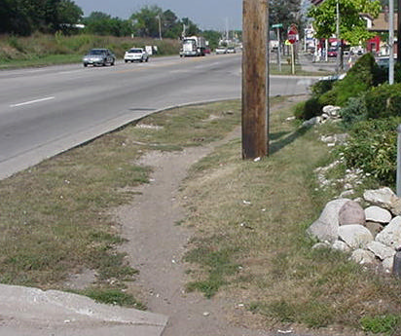
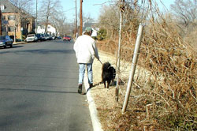
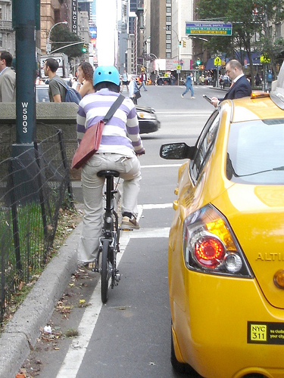
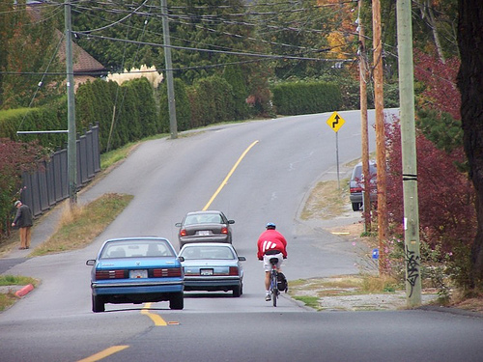

Slide 13

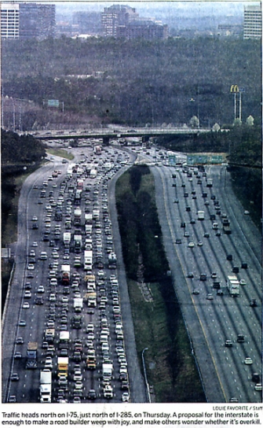
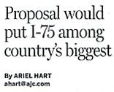
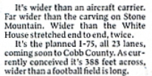
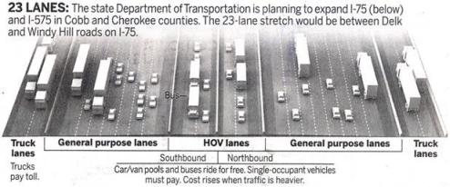
Transportation Planning and Land Use Choices
Source: Atlanta Journal-Constitution, March 10, 2006

Slide 14
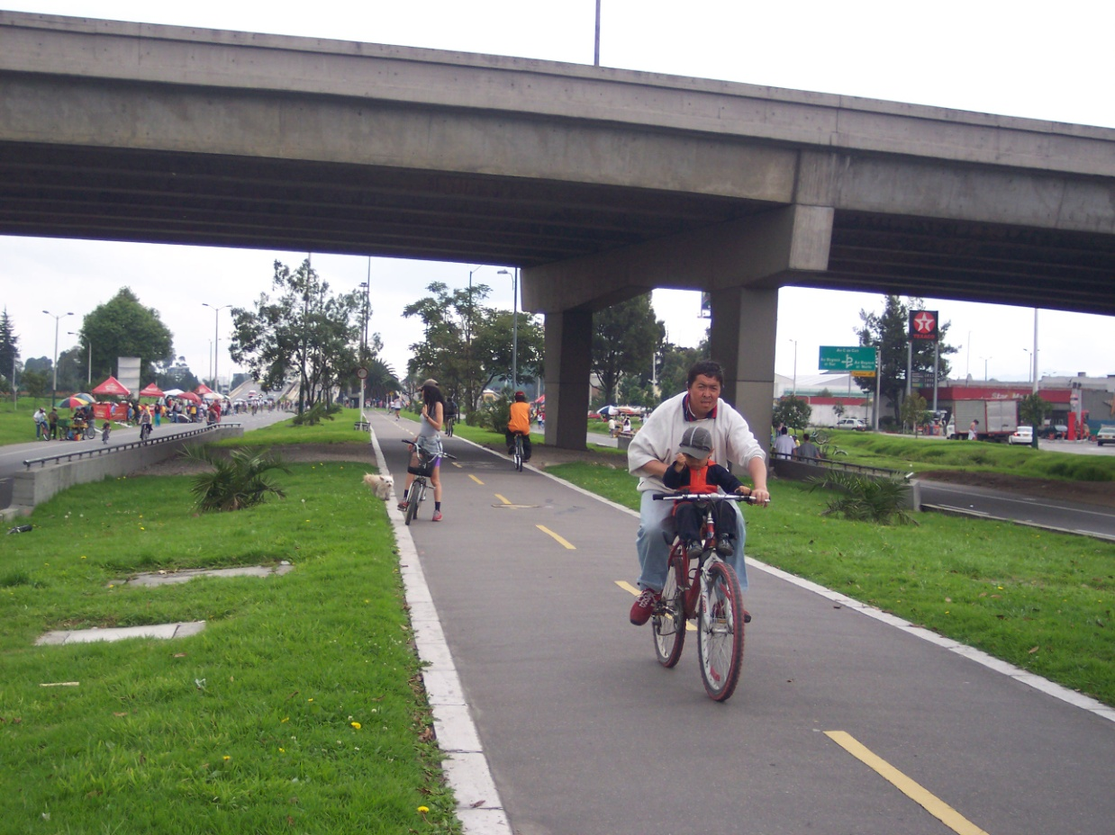
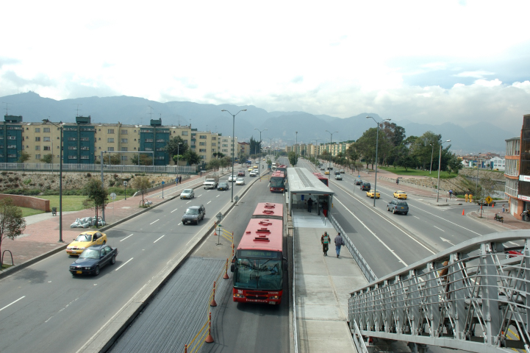

Slide 15
States included in AMP Study
Number of Plans Identified:
1-10 11-20 21-30 31-40 41+

Slide 16
Leading Research Questions
What set of policy tools are found in p/b master plans?
How do local plans depend upon or conflict with state policy? Do these policies differ by jurisdiction?
Do communities with more PA policy supports have more favorable active living environments?
What are the attributes of a good p/b plan?
What strategies are pursued to minimize barriers to plan implementation?
How does success correlate with degree of plan integration with other modal planning?
How does including non-transportation partners affect the policy content of plans?

Slide 17
Policies within B/P plans
Funding policies (supporting contributions to federal or state programs, tax incentives)
Restrictions or burdens on Ped/Bicycle mobility (e.g., walking or bicycling to school not permitted, restricting ped crossings across thoroughfares, etc.)

Slide 18
Policies, continued
Traffic-calming initiatives (including speed humps, curb extensions, chicanes, "road diets", etc.)
Transit interface enhancements (e.g., shelters, marked stops, kiosks, landscaping)
Maintenance of pedestrian or bicycle facilities (e.g., policies pertaining to the maintenance of sidewalks, trails, footpaths, crosswalks)
Policies or projects that specifically address equity/social justice (e.g., improving access to ped/bike facilities in lower-income neighborhoods)
Notes:
A road diet is a technique in transportation planning whereby a road is reduced in number of travel lanes and/or effective width in order to achieve systemic improvements.

Slide 19
Policies, continued
Visual disability policies or projects with mobility enhancements for vision-impaired people (blind, low-vision)
Physical disability policies or projects with mobility enhancements for mobility-impaired people (wheelchair users, people with walkers, etc.)

Slide 20
Policies, continued
Zoning Ordinances such as subdivision ordinances, and "concurrency" requirements (items governing development and supporting infrastructure)
Transit policies (bike racks, bike on transit)
State requirements/guidelines regarding the presence of facilities (for example State Department of Transportation adopted guidelines or warrants for pedestrian crossings, or policies for sidewalks on bridges or along roads, or bicycle access to limited access freeways)
Federal requirements and guidelines (such as the Americans with Disabilities Act/ADA)

Slide 21
Policies, continued
School siting guidelines
School policies facilitating walking/bicycling to local school
Bicycle helmet law (for adults and/or children under at certain age) existing or proposed

Slide 22
Conclusions
B/P plans, when implemented, may increase physical activity of residents
Many policies are included in B/P master plans.
Process in policy change needs to be addressed. (e.g. What is involved with changing policy?)
Plans with many stakeholders seem to get broader support.
Public health should be represented in the transdisciplinary planning team.
Notes:
Many plans are transportation heavy

Slide 23
Recommendations
  Contact your State Transportation Coordinator
  Work with regional advocacy agencies
  Work with planning agencies
  Learn the “lingo”
  Get to know stakeholders
  Remember that change takes time

